Slide 1


Prediction and Monitoring of Pollutants using IoT
By :
Guide : Shweta GN Co-Guide : Rajesh N
1. Rituraj
2. Abhinav Kumar
3. Vaibhav Katiyar
4. Siddhant Kumar Jaiswal

Slide 2
Abstract
Urbanization, industrialization, and regional economic integration have developed rapidly in the world in recent years. Air pollution has attracted more and more attention. Air pollution is composed of harmful gases and particulate matter. However, PM2.5 is the main particulate matter in air pollution.
We will be collecting data using sensors like Temperature Sensors, Humidity Sensors, Pressure Sensors, Gas Sensors. Gas sensors will give different concentration of gases in the atmosphere which will ultimately predict AQI(Air quality Index) level.
From that AQI level, we can predict the different respiratory diseases as when the concentration increases more than 200 ppm, it starts affecting the lungs, leading to diseases like asthma and lung cancer. The other parameters like temperature, humidity and pressure also affects the AQI level.

Slide 3
Introduction
Project uses air sensors to detect the existence of poisonous gases and compounds in the atmosphere and continuously delivering this data. The sensors communicate with Arduino which precedes this data and delivers over the requisition.
IoT technology support in developing a progress report of a device in a real-time environment. Internet of Things is an innovation that connects the sensors with the installed framework and enables the information from these sensors to go over the internet.
With The help of emerging technology of machine learning, collected data will be trained into a model which predict the air quality for various chronic diseases like lung cancer, stroke, asthma, bronchitis, etc.

Slide 4
Objectives
Sensing the concentration of different pollutants in the weather with the help of various sensors.
Storing the data gathered, in the data warehouse.
Using the stored data values to predict PM2.5 (Particulate Matter) concentration and get the AQI level and then even show what kind of diseases are prone to with such level of concentration.

Slide 5
Literature Survey
Work | Summary
K. Cornelius, N. K. Kumar, S. Pradhan, P. Patel and N. Vinay, "An Efficient Tracking System for Air and Sound Pollution using IoT," 2020 6th International Conference on Advanced Computing and Communication Systems | In this paper [1] the authors are concentrating on the framework on which the air and sound pollution can be tracked and monitored and the proposed model gives a warning when a dangerous level is reached. The paper is focused more on the overall model of the monitoring system and less on the actual sensing technology.
Kinnera, Bharath Kumar Sai & Subbareddy, Somula & Luhach, Ashish. (2019). IOT based Air Quality Monitoring System Using MQ135 and MQ7 with Machine Learning Analysis | This paper is focused on air quality sensing using MQ-135 and MQ-7 sensors and then performing machine learning analysis to provide visual graphical data which can be viewed by the public on the ThingSpeak platform. [2]

Slide 6
Continued…
Upon surveying various papers our team reached the conclusion that though there are many papers published concerning to IoT based air quality monitoring system they have not been thorough and detailed about all the gases that contribute to air pollution.
Our project aims to not only give a detailed insight on the various gases and particulate matter and their concentrations in the environment but also perform machine learning analysis on the data collected through variety of sensors to predict the AQI (Air Quality Index) level in the atmosphere.
The project will also co relate various environmental conditions like temperature, humidity, pressure, sound etc with the concentration of the pollutants.
Lastly the gathered data can eventually tell us what kind of diseases are likely to be caused with prolonged exposure to such levels of concentration.

Slide 7
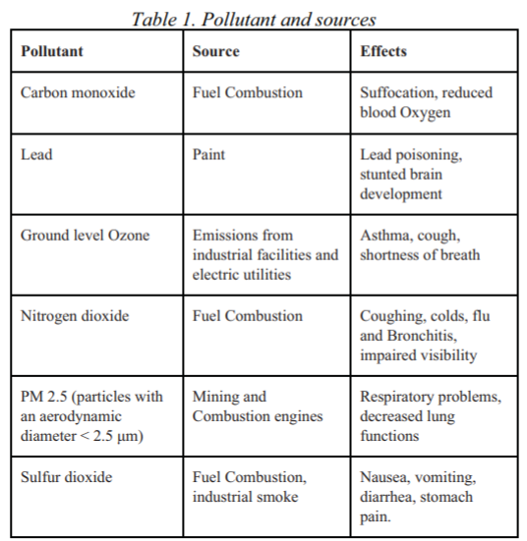
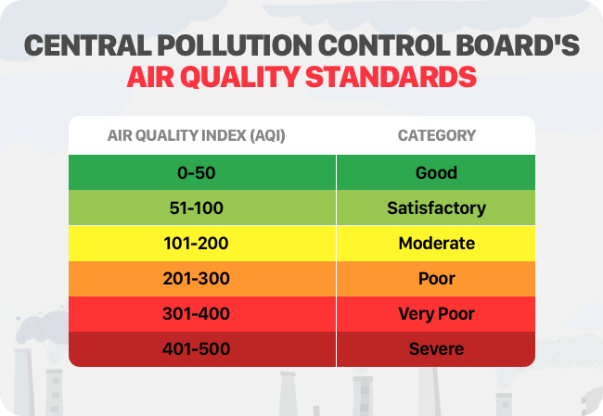
Table concerning various air pollutants,their sources and effects and the AQI level standards in India

Slide 8
As shown in previous table by Central Pollution Control Board, it explains about the Air Quality Index ranges.
Firstly, 0-50 PPM can be considered completely safe.
51-100 PPM can be considered as Moderate where this could be usually observed at traffic areas.
100- 200 PPM can be considered slightly unhealthy, only for sensitive groups.
201-300 PPM is completely unhealthy for all age groups.
301-400 PPM is quite harmful, where India capital New Delhi falls in this range.
401-500 PPM is very rare and it very hazardous, found mainly near coal mines.

Slide 9
Sensors
A sensor is a device that produces an output signal for the purpose of sensing of a physical phenomenon. It is a device, module, machine, or subsystem that detects events or changes in its environment and sends the information to other electronics.
Temperature sensor : A temperature sensor is a device used to measure temperature. This can be air temperature, liquid temperature or the temperature of solid matter. Gas sensor : Gas sensors (also known as gas detectors) are electronic devices that detect and identify different types of gases. Humidity sensor : A humidity sensor is an electronic device that measures the humidity in its environment and converts it into a corresponding electrical signal. Pressure sensor : A pressure sensor consists of a pressure-sensing element which can determine the pressure being applied and components to convert the

Slide 10
Continued…
Sound Detection Sensor : The sound sensor is one type of module used to notice the sound. Generally, this module is used to detect the intensity of sound.
Rain Detection Sensor : A rain sensor is one kind of switching device which is used to detect the rainfall. It works like a switch and the working principle of this sensor is, whenever there is rain, the switch will be normally closed.
PM 2.5 Sensor : Used for detecting PM10 and PM2.5 levels in air.

Slide 11
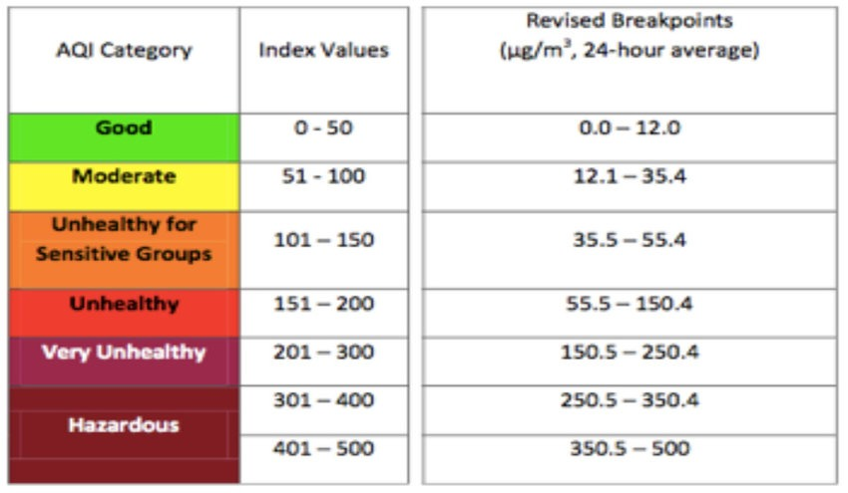
Relation Between PM2.5 and AQI
AQI is directly proportional i.e increase with increase in PM2.5 concentration level.

Slide 12
Existing System
Server
Sensors
ADC
Database
Web Browser
(analog-to-digital converter)
Web Service
Other Web-based Device

Slide 13
Sensors takes input from the environment.
The input is in the form of analog so ADC(Analog-to-Digital Converter) is used to convert it into digital form.
The digital data is then store into the Data Warehouse.
This data can be accessed by different web services and servers using APIs.
When some client request the data then server fetch it from the warehouse and deliver it to the client.

Slide 14
Proposed System
The proposed model is for detecting the AQI level and noise foulness in
the environment to make surrounding more rational and more interactive with the
objects through wireless communication.
Our System consist of Different Phases/Levels -
At Level 1, Sensors for Temperature, Gas ,Sound ,Rain, Humidity and Pressure
will give appropriate data.
At Level 2, All the gathered data through these sensors will be collected using Arduino.
At Level 3, Data will be stored in the server and will be provided for future usage.

Slide 15
At Level 4, All the gathered data will be used to train the model using various regression techniques like Linear Regression , Random Forest Regression , XGBoost Regressor , CatBoost Regressor , Stochastic Gradient Descent Regression , Kernel Ridge Regression , Elastic Net Regression , Bayesian Ridge Regression , Gradient Boosting Regression , Support Vector Machine.
At Level 5, the model with best accuracy will be chosen out of all to ultimately predict
AQI Level and give result for different weather conditions.

Slide 16
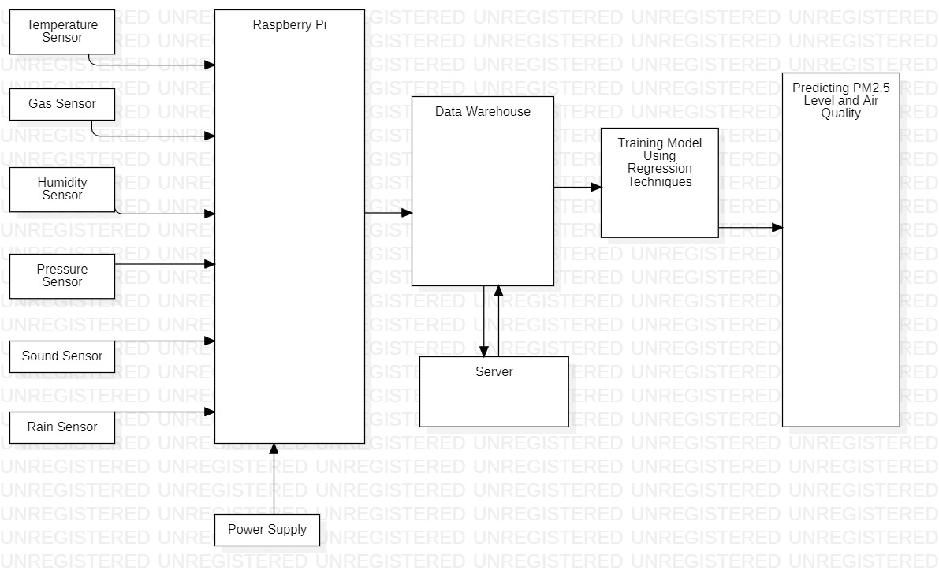
Design and Data Flow Diagram
Arduino

Slide 17
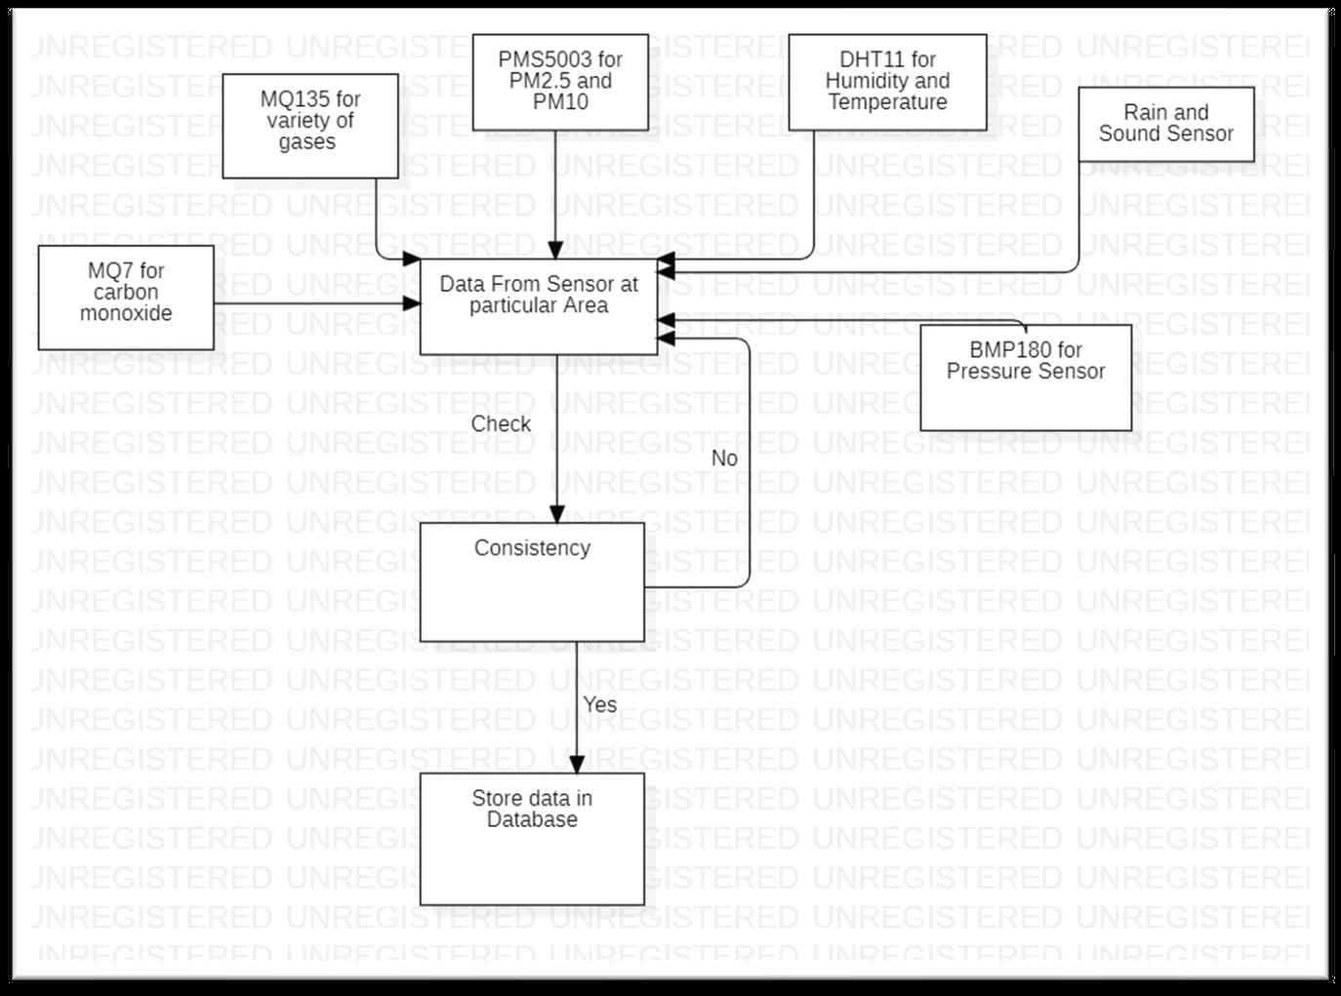
Phase 1 - Data Collection data Flow Diagram
In this Phase, all the data will be collected from different sensors that will be contributing towards predicting AQI level.
The collected data will be stored in from Arduino to the database file.

Slide 18
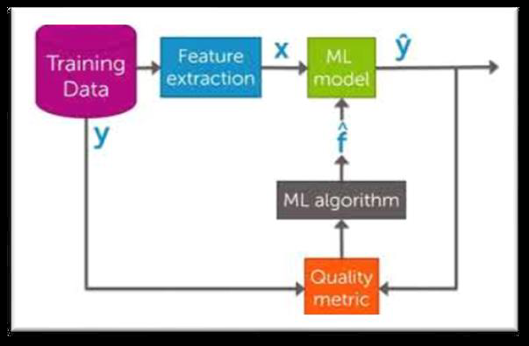
Phase 2 - Model Formation
The collected data will be trained by taking 30% dataset as test cases and 70% of dataset for training the model using Regression Analysis.
From This Model Design Features that is been extracted as X are different types of gases like NO,NH3,CO etc. and variable Y is the prediction value which will be PM2.5 concentration.

Slide 19
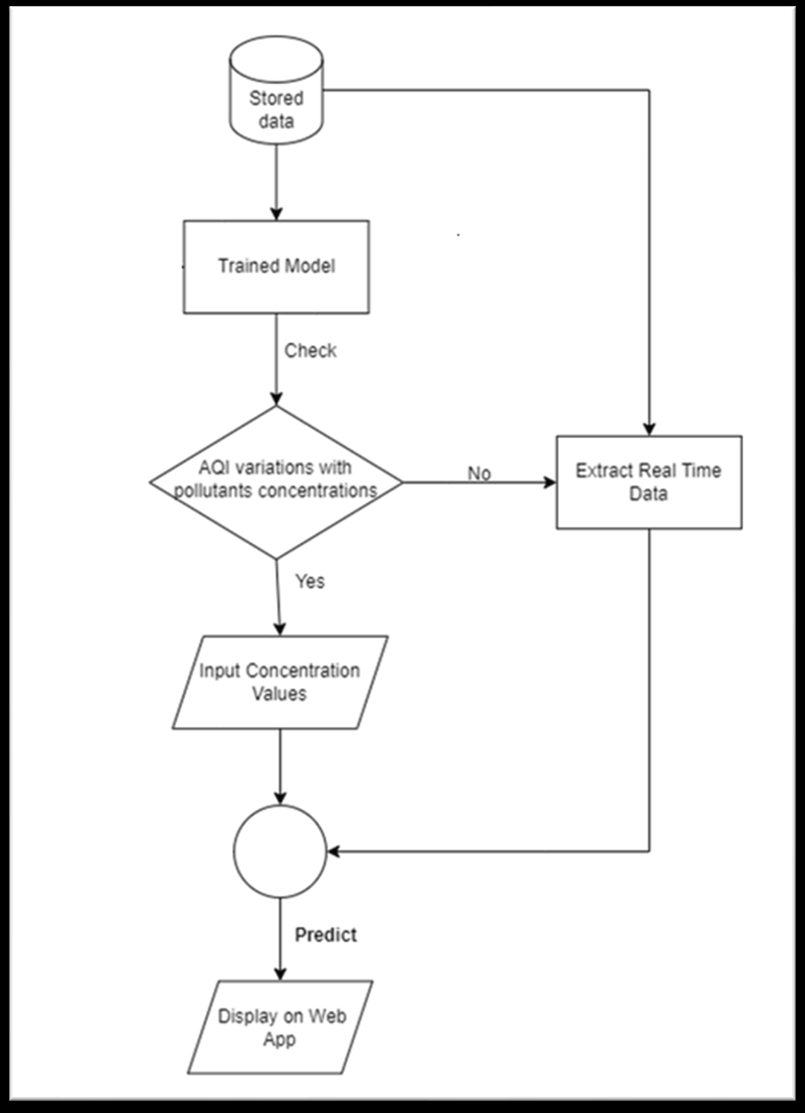
Phase 3 - UI Design
A web Interface is displayed to the users if they want to check the AQI variations with pollutant concentration like O3, CO, CO2, NO etc they can manually enter the data and the data should be valid, the valid ranges of concentration is given then the trained model will predict the PM 2.5 and AQI. If the user wants to get the real time value of PM2.5 and AQI from the environment, then the real time data will be extracted from the database and predict the PM2.5 and AQI.

Slide 20
Requirements
Software requirements: Operating System : Windows 10
Programming Language: Python, Sketch
Hardware Requirements:
Memory: 4 GB
RAM: 4 GB or above
Processor: i5 or above

Slide 21
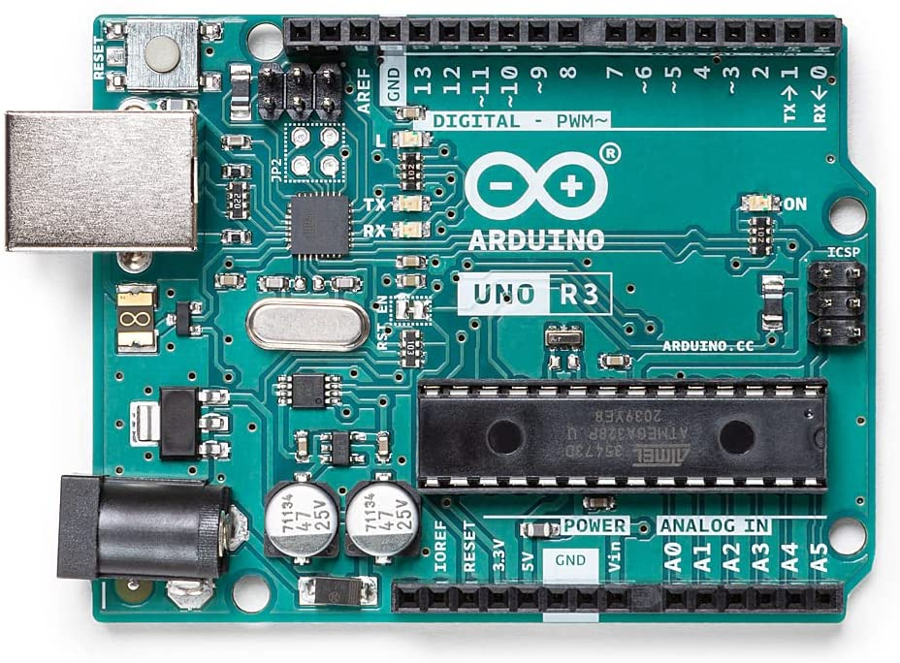
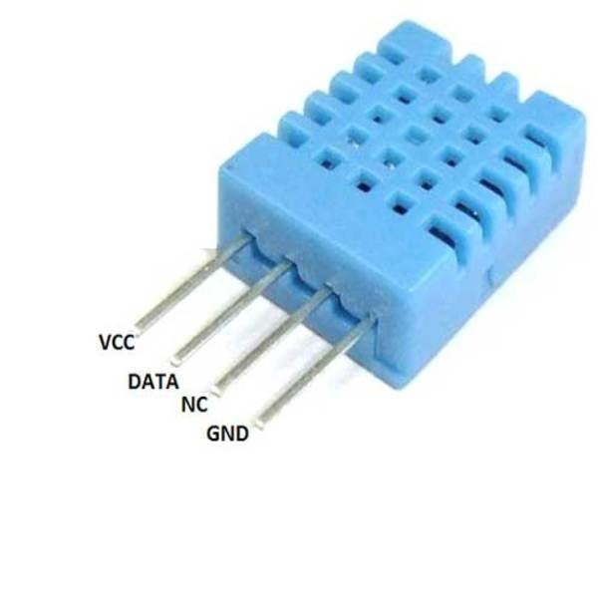
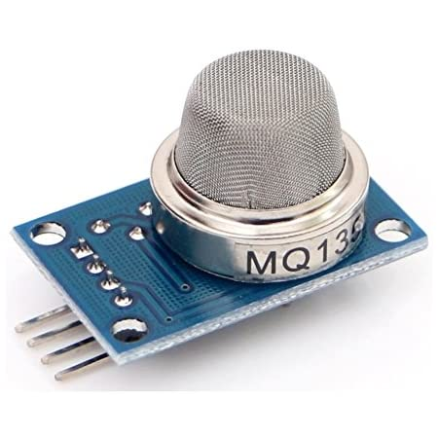
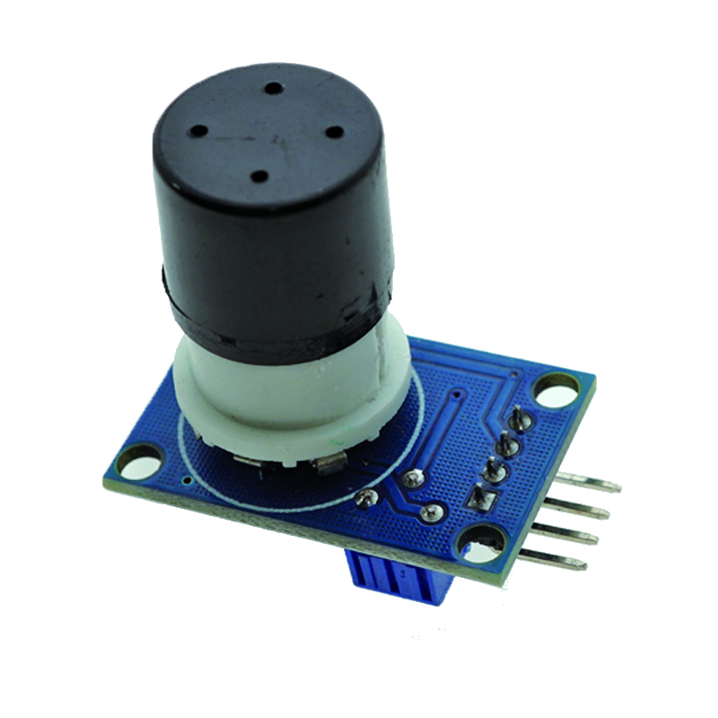
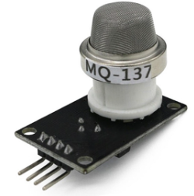
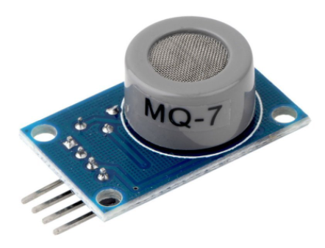
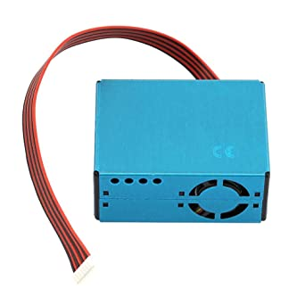
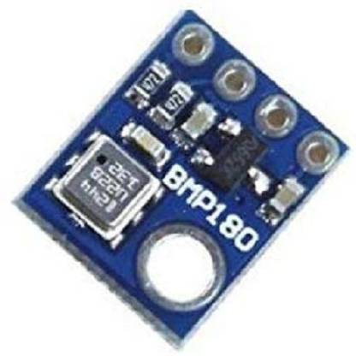
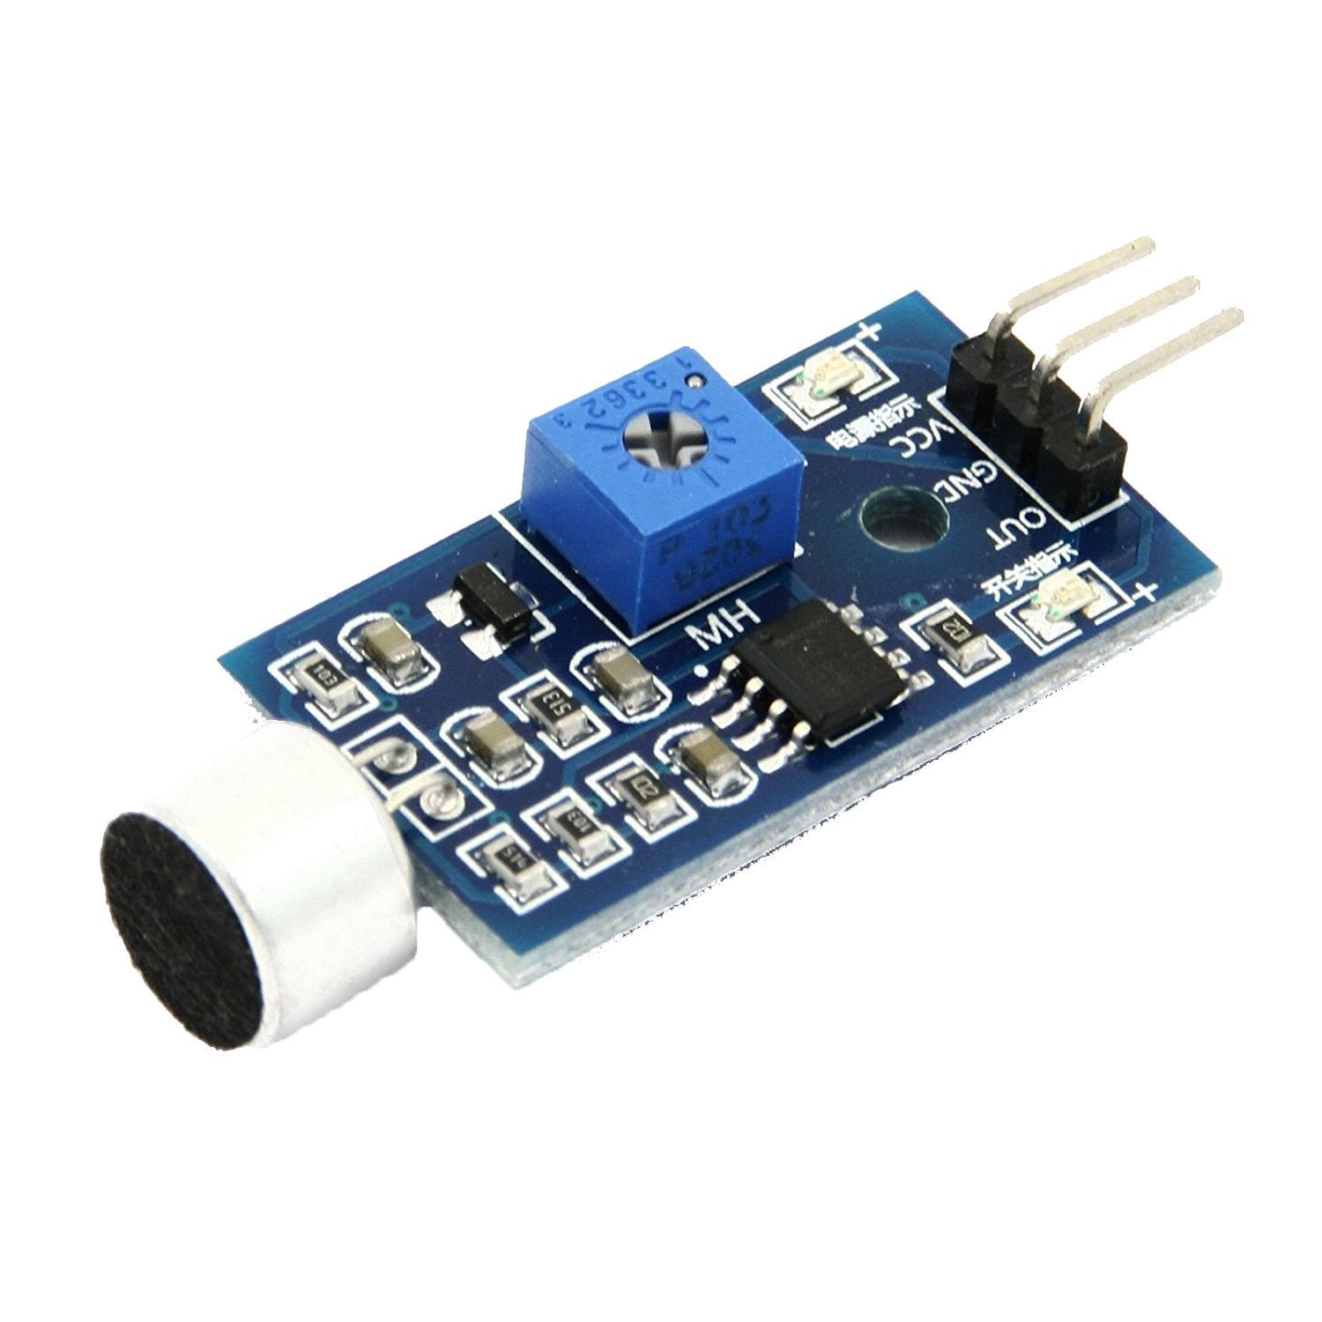
Additional Hardware Required
Arduino Uno
DHT11 Sensor (Temperature and Humidity Sensor)
MQ135 Sensor(for detection of methane, ammonia, NOx, benzene)
MQ131 Sensor (for detection of ozone gas)
MQ137 Sensor (for detection of ammonia gas)
MQ7 Sensor (for detection of CO gas)
PMS5003 Sensor (for detection of PM2.5 )
BMP180 (for measuring pressure)
Sound Detection Sensor (for detecting sound)
Rain Detection Sensor (for detecting rain)

Slide 22
Reference
[1] K. Cornelius, N. K. Kumar, S. Pradhan, P. Patel and N. Vinay, "An Efficient Tracking System for Air and Sound Pollution using IoT," 2020 6th International Conference on Advanced Computing and Communication Systems (ICACCS), 2020, pp. 22-25, doi: 10.1109/ICACCS48705.2020.9074301.
[2] Kinnera, Bharath Kumar Sai & Subbareddy, Somula & Luhach, Ashish. (2019). IOT based Air Quality Monitoring System Using MQ135 and MQ7 with Machine Learning Analysis. Scalable Computing: Practice and Experience. 20. 599-606. 10.12694/scpe.v20i4.1561.

